Slide 1
Decision Tree & Random Forest
Amal Joseph
Machine Learning Engineer @ Arcesium

Slide 2
Overview
Decision Tree Intuition
Decision Tree Classifier
Decision Tree Regressor
Random Forest Intuition

Slide 3

Decision Tree
Decision Tree is a Supervised learning technique that can be used for both classification and Regression problems, but mostly it is preferred for solving Classification problems.
It is a tree-structured classifier, where
internal nodes (decision node) represent the features of a dataset
branches represent the decision rules
each leaf node represents the outcome.

Slide 4
Why to use Decision Tree
Decision Trees usually mimic human thinking ability while making a decision, so it is easy to understand.
The logic behind the decision tree can be easily understood because it shows a tree-like structure.

Slide 5
Decision Tree Classifier
x₂
x₁

Slide 6
Decision Tree Classifier
Split 1
x₂
50
x₁

Slide 7
Decision Tree Classifier
Split 1
x₂
How is this split happening?
How to select the best attribute for the root node and for sub-nodes.
50
x₁

Slide 8
Decision Tree Classifier
Split 1
x₂
How is this split happening?
How to select the best attribute for the root node and for sub-nodes.
Attribute Selection Measure (ASM)
50
x₁

Slide 9
Decision Tree Classifier
Split 1
x₂
How is this split happening?
How to select the best attribute for the root node and for sub-nodes.
Attribute Selection Measure (ASM)
Information Gain_{(maximize)}
calculates how much information a feature provides us about a class
50
x₁

Slide 10
Decision Tree Classifier
Split 1
x₂
How is this split happening?
How to select the best attribute for the root node and for sub-nodes.
Attribute Selection Measure (ASM)
Information Gain_{(maximize)}
calculates how much information a feature provides us about a class
Gini Index_{(minimize)}
Gini index is a measure of impurity used while creating a decision tree
50
x₁

Slide 11
Decision Tree Classifier
Split 1
Split 2
x₂
50
75
x₁

Slide 12
Decision Tree Classifier
Split 1
Split 2
x₂
Split 3
50
50
75
x₁

Slide 13
Decision Tree Classifier
Split 1
Split 2
x₂
Split 4
80
Split 3
50
50
75
x₁

Slide 14
Where is the TREE here?
Split 1
Split 2
x₂
Split 4
80
Split 3
50
50
75
x₁

Slide 15
Where is the TREE here?
x₁ < 50
Split 1
Split 2
x₂
Split 4
80
Split 3
50
50
75
x₁

Slide 16
Where is the TREE here?
x₁ < 50
Split 1
Split 2
x₂
no
yes
Split 4
80
Split 3
50
50
75
x₁

Slide 17
Where is the TREE here?
x₁ < 50
Split 1
Split 2
x₂
no
yes
Split 4
80
x₂ < 50
Split 3
50
50
75
x₁

Slide 18
Where is the TREE here?
x₁ < 50
Split 1
Split 2
x₂
no
yes
Split 4
80
x₂ < 50
x₁ < 75
Split 3
50
50
75
x₁

Slide 19
Where is the TREE here?
x₁ < 50
Split 1
Split 2
x₂
no
yes
Split 4
80
x₂ < 50
x₁ < 75
yes
no
Split 3
50
50
75
x₁

Slide 20
Where is the TREE here?
x₁ < 50
Split 1
Split 2
x₂
no
yes
Split 4
80
x₂ < 50
x₁ < 75
yes
no
Split 3
50
50
75
x₁

Slide 21
Where is the TREE here?
x₁ < 50
Split 1
Split 2
x₂
no
yes
Split 4
80
x₂ < 50
x₁ < 75
yes
no
Split 3
50
50
75
x₁

Slide 22
Where is the TREE here?
x₁ < 50
Split 1
Split 2
x₂
no
yes
Split 4
80
x₂ < 50
x₁ < 75
no
yes
no
yes
Split 3
50
50
75
x₁

Slide 23
Where is the TREE here?
x₁ < 50
Split 1
Split 2
x₂
no
yes
Split 4
80
x₂ < 50
x₁ < 75
no
yes
no
yes
Split 3
50
x₂ < 80
50
75
x₁

Slide 24
Where is the TREE here?
x₁ < 50
Split 1
Split 2
x₂
no
yes
Split 4
80
x₂ < 50
x₁ < 75
no
yes
no
yes
Split 3
50
x₂ < 80
yes
no
50
75
x₁

Slide 25
Classifying a new data point
x₁ < 50
Split 1
Split 2
x₂
no
yes
Split 4
80
x₂ < 50
x₁ < 75
no
yes
no
yes
Split 3
50
x₂ < 80
yes
no
50
75
x₁

Slide 26
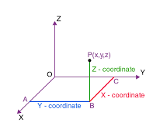
Decision Tree Regression
x₂
x₁

Slide 27
Decision Tree Regression
Split 1
Split 2
x₂
Split 4
80
Split 3
50
50
75
x₁

Slide 28
Decision Tree Regression
Split 1
Split 2
x₂
Find the average of each group/ split
Split 4
80
Split 3
50
50
75
x₁

Slide 29
Decision Tree Regression
Split 1
Split 2
x₂
300.5
Find the average of each group/ split
Split 4
80
Split 3
50
50
75
x₁

Slide 30
Decision Tree Regression
Split 1
Split 2
x₂
300.5
Find the average of each group/ split
35
Split 4
80
Split 3
50
50
75
x₁

Slide 31
Decision Tree Regression
Split 1
Split 2
x₂
300.5
Find the average of each group/ split
35
-74
Split 4
80
125
Split 3
50
210
50
75
x₁

Slide 32
Decision Tree Regression
x₁ < 50
Split 1
Split 2
x₂
300.5
no
35
-74
yes
Split 4
80
x₂ < 50
x₁ < 75
125
no
yes
no
yes
Split 3
50
210
210
300.5
35
x₂ < 80
yes
no
125
-74
50
75
x₁

Slide 33
Predicting a new data point?
x₁ < 50
Split 1
Split 2
x₂
no
yes
Split 4
80
x₂ < 50
x₁ < 75
no
yes
no
yes
Split 3
50
210
300.5
35
x₂ < 80
yes
no
125
-74
50
75
x₁

Slide 34
Predicting a new data point?
x₁ < 50
Split 1
Split 2
x₂
no
yes
Split 4
80
x₂ < 50
x₁ < 75
no
yes
no
yes
Split 3
50
210
300.5
35
x₂ < 80
yes
no
125
-74
50
75
x₁

Slide 35
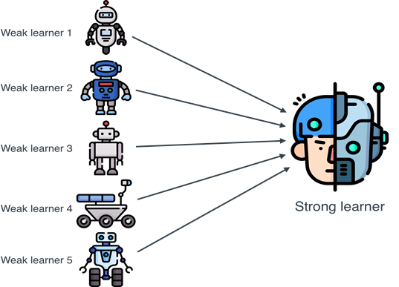

Slide 36
Random Forest
Random Forest is a classifier that contains a number of decision trees on various subsets of the given dataset and takes the average to improve the predictive accuracy of that dataset.
It is based on the concept of ensemble learning, which is a process of combining multiple classifiers to solve a complex problem and to improve the performance of the model.

Slide 37
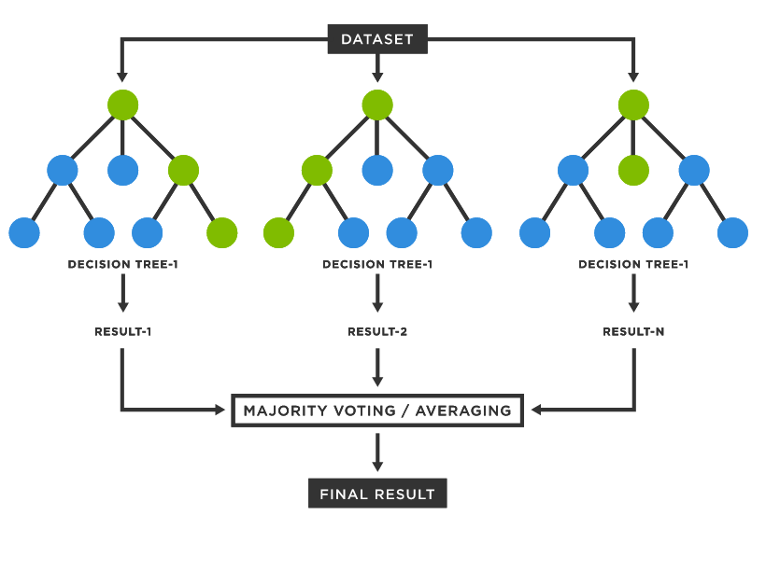

Slide 38
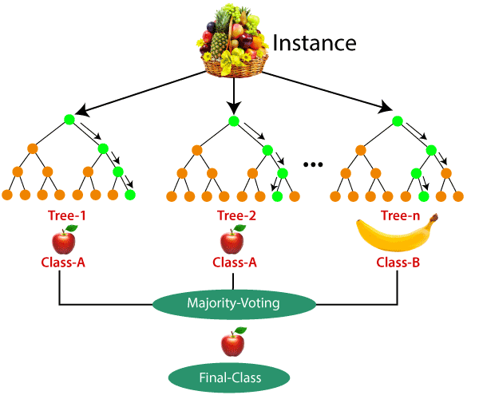

Slide 39
Why use Random Forest?
It takes less training time as compared to other algorithms.
It predicts output with high accuracy, even for the large dataset it runs efficiently.
It can also maintain accuracy when a large proportion of data is missing.

